Slide 1
CT Sim
Firewall
AD DC
ARIA Replication
ARIA
Linac
DNS
3.b
Brachy
Cerner
RT-DP Data Helper
Ortho
1
2
Backup Repo 01 Immutable
Veeam
3.a
3.c
4
SQL Query
Files: Doc, DCM
Faked I: Drive
Backup and Replication
Backup Repo 02
Immutable
Backup Repo 03
Cloud Based
Emergency Preparedness System Behind Firewall
DICOM for File Mode Treatment

Slide 2
ARIA System
ARIA DB
VMSDBD
File Server
3.b
Data Helper
Firewall
4
1.a
1.b
1.c
1.d
2
3.a
3.c
Patient List and Info
Questionnaires and Journal
RP/CT/RS/RI SeriesUID
Files and Locations
DICOM RP/CT/RS/RI
Doc and DICOM Files
Isolated RT Emergency Preparedness Module
RT-DP data retrieving illustration. After NIC enabled at scheduled time, 1.a-1.d: SQL queries of Aria DB; 2: DICOM C-MOVE based on SeriesUID queried from step 1.c; 3.a: files copy request based on the result of 1.d; 3.b: file copy from RT file/image server; 3.c: file copy from data helper; 4: send a copy of files from all previous steps to data helper. NIC will be disabled after all steps.

Slide 3
CBCT Recon WS
Treat Console WS
IRM WS
Service WS
Imaging Network Switch
Console Network Switch
Juniper
TrueBeam 2.x
Linac vLan
TrueBeam ←→ Servers Switch/Router
Server vLan
Supporting WS
I: Drive Server
Copy to
RT-DP Tx Module for TB 2.x
RT-DP Data Query and Storage

Slide 4
CBCT Recon WS
Treat Console WS
IRM WS
Service WS
Imaging Network Switch
Console Network Switch
Juniper
TrueBeam
Supporting WS
Physical Switch
Eclipse
Linac vLan
IMG
RT-DP Tx Module for All Linacs including TB 3.x/4.x
Virtual Firewall Switch
AD DC
DCM
Server vLan
Copy to
VSP
DCF
RT-DP Data Query and Storage
VA_TRANSFER SMB Svr (I: Drive)
ARIA DB
FAS
Virtual Environment

Slide 5
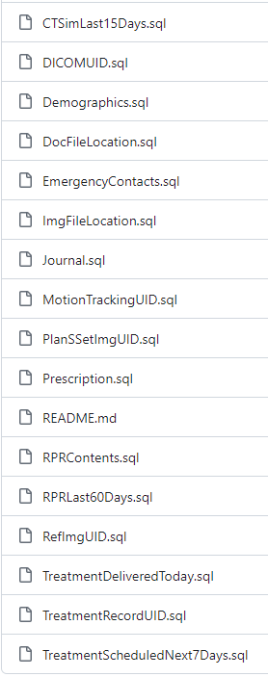
A. Data Required for Emergency Treatment
Patient Queries:
Patients with RPR in the last two months
Patients have CTSim done in the last two weeks
Patients have RT Plan Reviewed and Approved in the last two weeks
Patients received treatment today
Patients have treatment scheduled for the next 7 days
RPR Info (Questionnaires)
Quick Notes: setup info, treatment notes, physician orders etc. (Journal)
Prescription
Patient demographics, contacts, and health insurance info
Data Moving: Patient Scheduled for the next 7 days:
Files for DICOM RT mode treatment: DICOM CT, RP, RS, RI
Other DICOM files: Tx Records, RGSC Motion Tracking
Patient documents: CTSim/planning notes, QA doc etc.

Slide 6
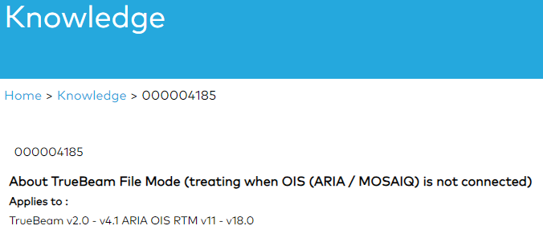
B. DICOM RT Mode -- TrueBeam
To use File Mode the following is required:
DICOM Plan files uploaded to the I: drive. These must have been exported from the OIS in advance
Access to the network I: drive (in order to access Patient DICOM files) from the TrueBeam
Access to OSP/VSP for User Rights
  If OSP is offline, credentials are held / cached locally on the TrueBeam for 5 days
If the network is down (1), or there is no connectivity to the I: drive (2), or the DICOM Plan files were not exported from the OIS system in advance (3), then there is no workaround to treat patients on the TrueBeam
File Mode Has Some Risks, such as the potential to treat the wrong patient, wrong anatomy or wrong field, if care is not taken

Slide 7
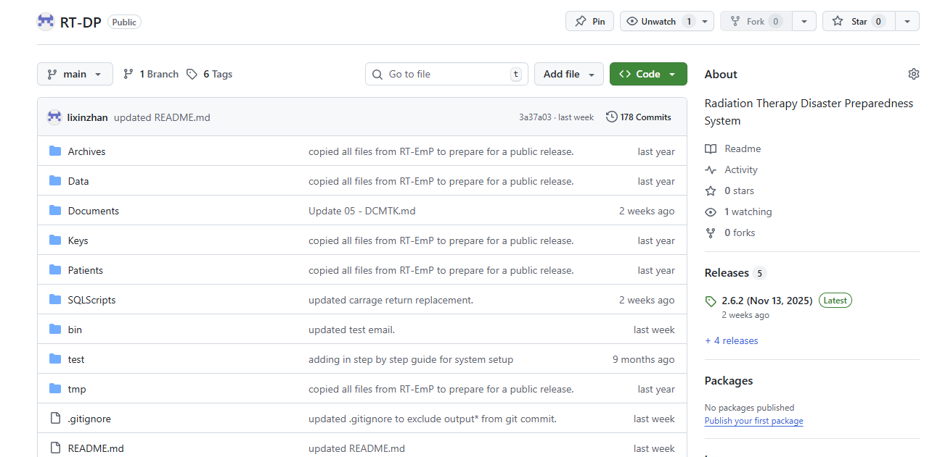
C. RT-DP on GitHub [https://github.com/lixinzhan/RT-DP]

